Slide 1
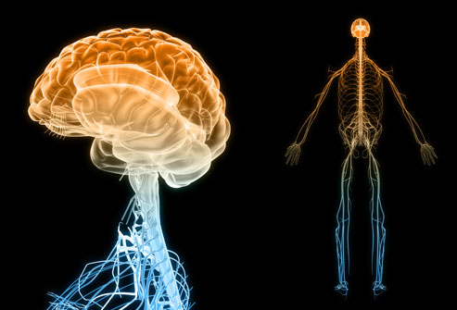
The Nervous System

Slide 2
Homeostasis
Homeostasis is the maintenance of a constant internal environment.
We require such an environment inside our bodies to enable cells to function at an optimum level.

Slide 3
Continued.
Cells are surrounded by fluid, and it is the composition and temperature of this fluid that must be maintained within very fine limits.
Homeostasis ensures that the fluid environment of the cells:
Contains the optimum concentration of nutrients, ions, gases and water
Stays at a constant temperature- the optimum temperature for normal cell functioning
Is maintained at the optimum pressure

Slide 4
Continued.
The maintenance of this balance doesn’t mean nothing changes
To maintain homeostasis the body must be able to sense changes in the internal and external environment and must be able to compensate for those changes.

Slide 5
Continued.
The nervous and endocrine systems are the main sensory and controlling body systems and, in the case of homeostasis, they operate through feedback systems, many of which involve negative feedback.

Slide 6
Nervous Systems
One of the body’s two communication systems
Coordinates all our voluntary and involuntary actions with the endocrine system
The essential purpose of the nervous system is to receive and process information from sense organs

Slide 7
Continued.
The nervous system consists of the brain, spinal cord and all the nerves.
The two main parts of the nervous system are called the Central Nervous System (CNS) and the Peripheral Nervous System (PNS).

Slide 8
Continued.
The CNS (aka Control Centre) consists of the brain and spinal cord, while the nerves that connects the CNS with the receptors, muscles and glands make up the PNS.
The PNS consists of nerve fibres, which carry information to and from the CNS, and groups of nerve cell bodies, called GANGLIA, which lie outside the brain and spinal cord.

Slide 9
Continued.
The nerve fibres are arranged into nerves, which arise from the brain and the spinal cord.
Most cranial nerves are mixed nerves, that is, they contain fibres that carry impulses into the brain as well as fibres that carry impulses away from the brain.
Fibres that carry impulses into the CNS are called sensory fibres; those that carry impulses away from the CNS are motor fibres.

Slide 10
Continued.
Spinal nerves arise from the spinal cord
They are joined to the spinal cord by two roots
The ventral root contains the axons of motor neurons that have their cell bodies in the grey matter of the spinal cord.
The dorsal root contains the axons of sensory neurons that have their cells bodies in the dorsal root ganglion.

Slide 11
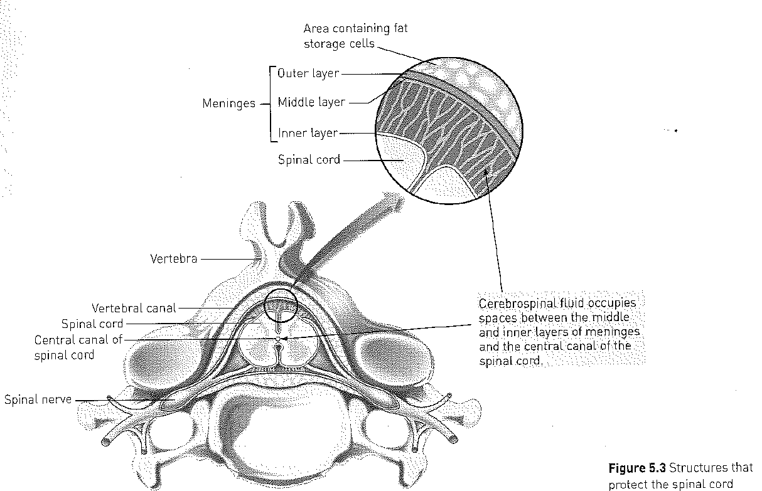
Part of the Spinal Cord

Slide 12
Protection of the CNS
The brain and spinal cord are very delicate and vital parts of the body and are heavily protected.
The CNS is protected by
Bone
Membranes called meninges
Cerebrospinal fluid (CSF)

Slide 13
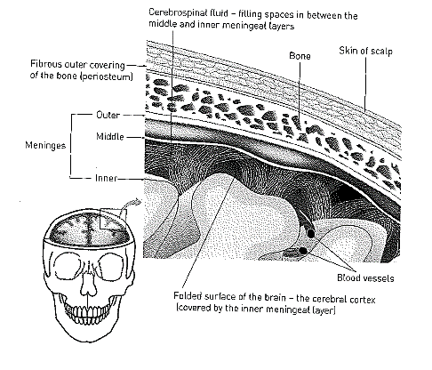
Structures that protect the brain

Slide 14
Complete the following table
Structure | How does it protect the brain?
Bone
Meninges
Cerebrospinal fluid

Slide 15
The Brain
We will have a look at the
Brain stem
Cerebrum
Cerebellum
Hypothalamus

Slide 16
Brain stem
The brainstem (or brain stem) is the posterior stalk-like part of the brain that connects the cerebrum with the spinal cord.
In the human brain the brainstem is composed of the midbrain, the pons, and the medulla oblongata.
The brainstem is very small, making up around only 2.6 percent of the brain's total weight.

Slide 17
Cerebrum
Biggest part of the brain
Consists of an outer surface of grey matter (about 2-4mm thick) known as the cerebral cortex.
Below the cortex is white matter, and deep inside the cerebrum is additional grey matter called the basal ganglia.

Slide 18
Continued.
The cerebral cortex is folded in patterns that greatly increase its surface area.
The cerebral cortex is involved in activities such as thinking, reasoning, learning, memory, intelligence, and sense of responsibility. It is also concerned with perception of the sense and initiation and control of voluntary muscle contraction.

Slide 19
Continued.
There are three types of functional areas in the cortex:
Sensory areas: interpret impulses from receptors
Motor areas: control muscular movements
Association areas: concerned with intellectual and emotional processes

Slide 20
Cerebellum
Lies under the rear part of the cerebrum
Second largest part of the brain and its surface is folded into a series of parallel ridges
Outer= grey matter
Inner= white matter

Slide 21
Continued.
Exercises control over posture, balance and the fine coordination of voluntary muscle movement
Receives info from the ear and from receptors in the skeletal muscles
All the functions of the cerebellum and so without it we could still move, but our movements would be spasmodic, jerky and uncontrolled.
Smooth, coordinated movements such as writing would be impossible.

Slide 22
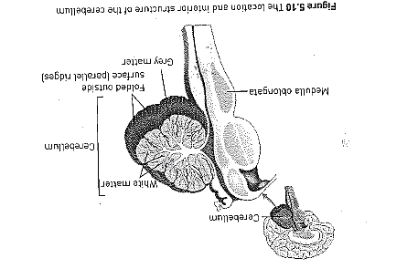
The location and interior structure of the cerebellum

Slide 23
Hypothalamus
Lies in the middle of the brain and cannot be seen from the outside.
Although small, the hypothalamus controls many body activities, it is mostly concerned with homeostasis

Slide 24
Functions of the Hypothalamus
Regulating the
Autonomic Nervous System
Body temperature
Food and water intake
Patterns of sleeping and waking
Emotional responses
Secretion of hormones and coordination of parts of the endocrine system

Slide 25
Continued.
Cranial and spinal nerves make up the PNS contain fibres that carry nerve impulses to and from all parts of the body.
The PNS is divided into parts

Slide 26
Continued.
The Afferent (or sensory) division:
Fibres that carry impulses into the PNS. These impulses are carried into the CNS by sensory nerve cells from receptors in the skin and around the muscles and joints. These nerve cells from the body are called somatic sensory neurons.
Afferent division of the PNS also has sensory nerve cells that take impulses from the internal organs into the CNS. These are called visceral sensory neurons

Slide 27
Continued.
The efferent (or motor) division has fibres that carry impulses away from the CNS.
It is subdivided into:
the somatic division (sometimes called the somatic nervous system), which takes impulses from the CNS to the skeletal muscles
the autonomic division (autonomic nervous system), which carries impulses from the CNS to heart muscle, involuntary muscle and glands.

Slide 28
Continued.
The autonomic division is further divided into:
The sympathetic division (sympathetic nervous system)
The parasympathetic division (parasympathetic nervous system).

Slide 29
Central Nervous System
Brain and Spinal Cord
Peripheral Nervous System
12 pairs of cranial nerves and 31 pairs of spinal nerves, each of which may contain fibres of the various divisions
Afferent division-
Carrying information INTO the CNS
Efferent division-
Carrying information AWAY from the CNS
Somatic division-
Carrying messages to the skeletal muscles
Autonomic division-
Carrying messages to heart and involuntary muscles and glands
Somatic sensory neurons from skin and muscle
Visceral sensory neurons from internal organs
Sympathetic division
Parasympathetic division

Slide 30
The Autonomic Nervous System
The ANS is a part of the PNS
The ANS is responsible for the control of the body’s internal environment and is involved in many of the mechanisms that keep the internal environment constant.
It usually operates without conscious control and is regulated by groups of nerve cells in the brain (medulla oblongata, hypothalamic and cerebral cortex).

Slide 31
Continued.
Some of the body functions regulated by the autonomic division include heart rate, blood pressure, body temperature, digestion, release of energy, pupil diameter, air flow to the lungs, defecation and urination.

Slide 32
Continued.
The nerve fibres of the ANS make up part of the spinal nerves and part of some of the cranial nerves.
They carry impulses to the heart muscle, other muscles of the internal organs and the glands.
The pathway travelled by an impulse from the CNS to an organ controlled by the ANS consists of two neurons.

Slide 33
Continued.
One of these has its cell body in the CNS, but the cell body of the other is in a ganglion. A ganglion (plural, ‘ganglia’) is a group of nerve cell bodies outside the CNS.
Most nerve cell bodies are in the grey matter of the brain or spinal cord, but when they occur outside the CNS they are grouped in ganglia.

Slide 34
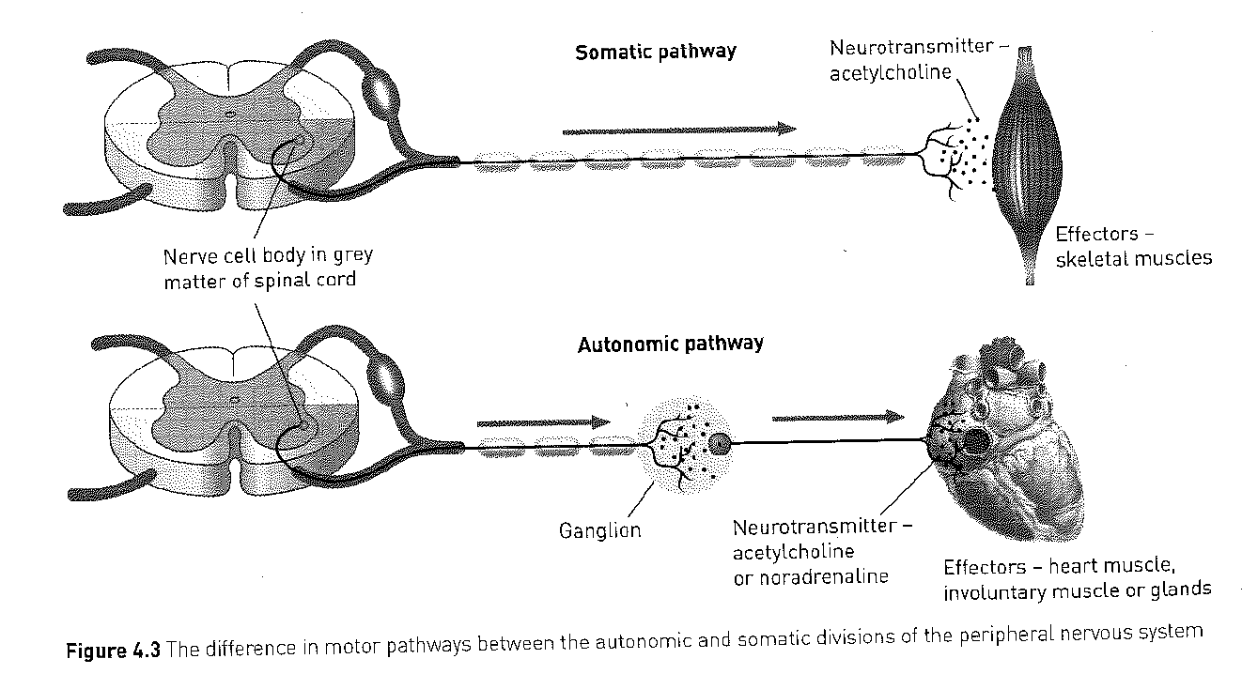

Slide 35
A COMPARISON BETWEEN THE AUTONOMIC AND SOMATIC DIVISIONS OF THE PNS
Characteristic | Autonomic Division | Somatic Division
Effectors | Heart muscles, involuntary muscle, glands | Skeletal (voluntary) muscles
General function | Adjustment of the internal environment (homeostasis) | Response to the external environment
Efferent (outward) pathways | Two nerve fibres from the CNS to the effector with a synapse in a ganglion | One nerve fibre from the CNS to the effector; no synapse and no ganglion
Neurotransmitter at effector | Acetylcholine or noradrenaline | Acetylcholine
Control | Usually involuntary | Usually voluntary
Nerves to target organ | Two sets- sympathetic and parasympathetic | One set
Effect on target organ | Excitation or inhibition | Always excitation

Slide 36
The differences in divisions
The parasympathetic division generally produces responses that maintain the body during relatively quiet conditions.
The sympathetic division, on the other hand, tends to produce responses that prepare the body for strenuous physical activity (fight-or-flight responses).

Slide 37
A summary of the effects of the autonomic nervous system
Structure | Effect of sympathetic stimulation | Effect of parasympathetic stimulation
Heart | Increases rate and strength of contraction | Decreases rate and strength of contraction
Lungs | Dilates bronchioles (fine air passages in the lungs) | Constricts bronchioles
Stomach, intestines | Decreases movement | Increases movement
Liver | Increases breakdown of glycogen and release of glucose | Increases uptake of glucose and synthesis of glycogen
Iris of the eye | Dilates pupil | Constricts pupil
Blood vessels of: skin skeletal muscles internal organs | Constricts vessels Dilates vessels Constricts vessels (except in heart and lung) | Little effect No effect Little effect

Slide 38

Flight or Fight
In threatening situations the balance between the sympathetic and parasympathetic stimulation is upset and the sympathetic becomes dominant. E.g. danger situations.
These responses prepare the body for increased activity and include
Increased heart rate
Blood vessels dilate or constrict
Rate of breathing increases
Adrenaline is released

Slide 39
A comparison of the nervous and endocrine systems
Characteristic | Nervous System | Endocrine System
Nature of message | Electrical impulses and neurotransmitters | Hormones
Transport of message | Along the membrane of neurons | By the bloodstream
Cells affected | Muscle and gland cells; other neurons | All body cells
Type of response | Usually local and specific | May be very general and widespread
Time taken to respond | Rapid- within milliseconds | Slower- from seconds to days
Duration of response | Brief- stops quickly when the stimulus stops | Longer lasting- may continue long after the stimulus has stopped

Slide 40
Stimulus-response models

Slide 41
Stimulus: A change in environment occurs
Receptor: stimulus is detected by sensory cells
Message: sensory cells generate a message in the form of a nerve impulse or hormone
Modulator: a new message is sent out by the modulator
Effector: muscles or glands receive the message from the modulator
Response: effector organs bring about an appropriate reaction
Feedback: response changes the original stimulus

Slide 42
Negative Feedback Loops
In homeostatic mechanisms the response has the effect of reducing or eliminating the stimulus that caused it
E.g. Let’s suppose you feel cold. In response to the stimulus of feeling cold you put on a jumper and no longer feel cold. Your response has reduced or eliminated the original stimulus of feeling cold.

Slide 43
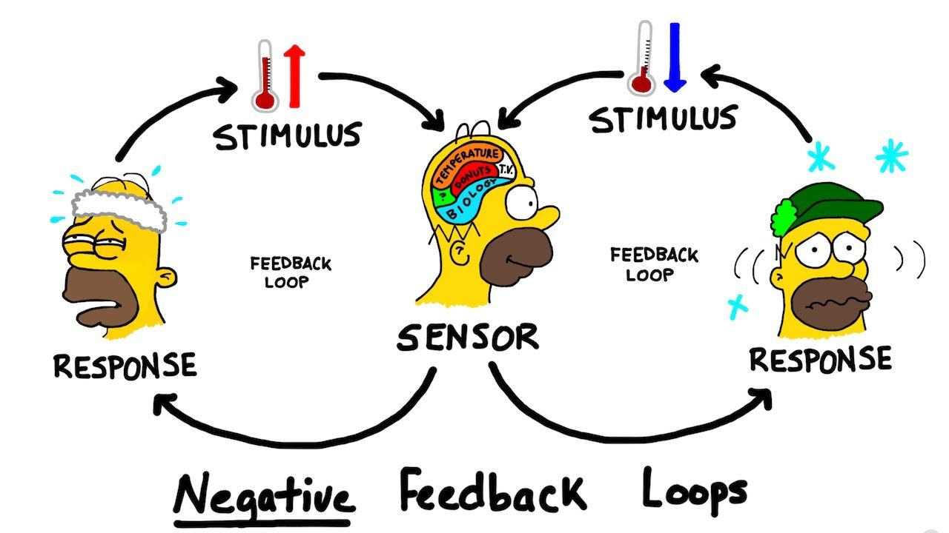

Slide 44
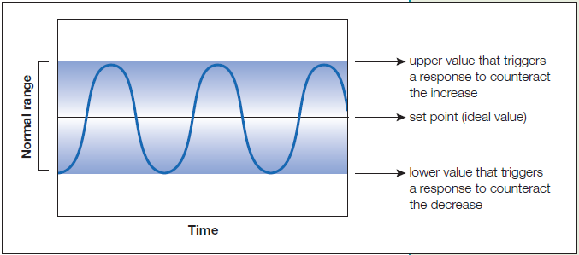

Slide 45
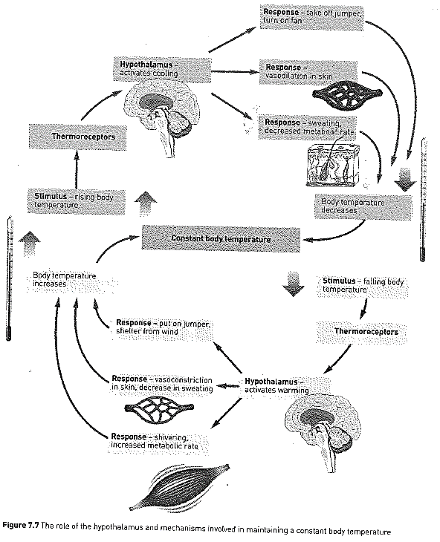
Copy this.

Slide 46
Receptors
A receptor is a structure that is able to detect a change in the body’s internal or external environment.
Sometimes receptor cells of a particular type are grouped together in a sense organ, such as the light receptors in the eye, or the sound receptors sensitive to sound vibrations in the ear.

Slide 47
Thermoreceptors
Thermoreceptors are able to respond to heat and cold
In the skin are thermoreceptors that inform the brain of changes in the temperature outside the body.
The information is received by the hypothalamus and also by the cerebrum so we are consciously aware of the temperature of our surroundings.

Slide 48
Continued.
Skin thermoreceptors are nerve endings that are sensitive to either heat or cold but not both.
If the skin is tested with hot and cold probes it is found that there are definite hot spots and cold spots, depending on the thermoreceptors present

Slide 49
Continued.
The temperature inside the body (the core temperature), is monitored by thermoreceptors in the hypothalamus
These detect the temperature of the blood that is flowing through the brain.
Using information from the skin and internal thermoreceptors, the hypothalamus is able to regulate body temperature.

Slide 50
Osmoreceptors
Osmotic pressure is determined by the concentration of substances dissolved in the water of the blood plasma.
Osmoreceptors are located in the hypothalamus and are sensitive to osmotic pressure.
They respond to very small changes in osmotic pressure and are able to stimulate the hypothalamus so that the body’s water content is maintained within very narrow limits.

Slide 51
Chemoreceptors
Chemoreceptors are stimulated by particular chemicals
They are present in the nose, making us sensitive to odours, and in the mouth, giving us sensitivity to tastes.
There are also internal chemoreceptors that are sensitive to the composition of the body fluids.

Slide 52
Continued.
There are chemoreceptors that are sensitive to the composition of the body fluids.
Of particular importance are chemoreceptors in certain blood vessels that are sensitive to the pH of the blood and to the concentrations of oxygen and carbon dioxide.
These are involved in the regulation of the heartbeat and of breathing.

Slide 53
Touch receptors
Are mainly found in the skin and there are a number of different types.
Some are close to the surface of the skin and are sensitive to very light touches
These occur in greater concentrations in areas of skin that are more sensitive, such as the lips, fingertips, eyelids, and external genital organs.

Slide 54
Continued.
Nerve endings are also associated with the base of each hair follicle
These respond to any light touch that bends the hair

Slide 55
Continued.
Touch receptors close to the skin surface and those attached to the hairs adapt rapidly, and so after a short time we are no longer aware of the touch.
For example, when first putting on clothing we are aware of it touching our skin, but that sensation disappears very quickly
Other touch receptors are located deeper in the skin and are sensitive to pressure or vibration

Slide 56
Pain receptors
Also called nociceptors
Stimulated by damage to the tissues, such as from a cut or a heavy bump, by poor blood flow to a tissue, or by excessive stimulation from stimuli such as heat or chemicals.
The receptors for pain are especially concentrated in the skin and the mucous membranes

Slide 57
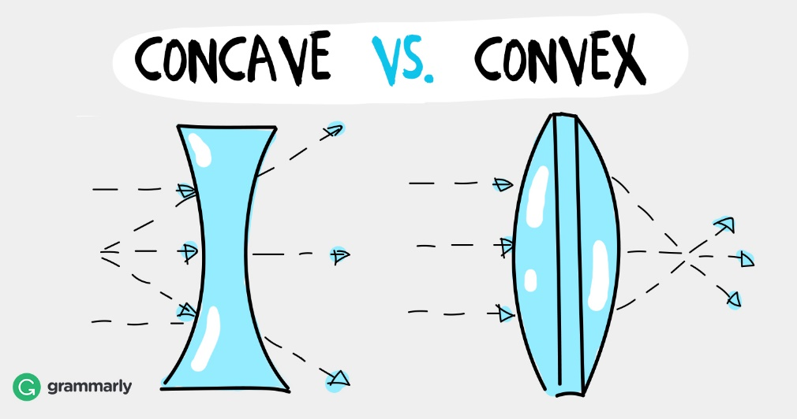
Structure of the eye.
Light that enters the eye is refracted by the cornea and focused by the lens, which is convex.
Incoming light is focused to form a clear, upside-down image on the retina, at the back of the eye.
This image is converted into a series of electrical signals, which then travel along the optic nerve to the brain. The brain interprets this as an image.

Slide 58
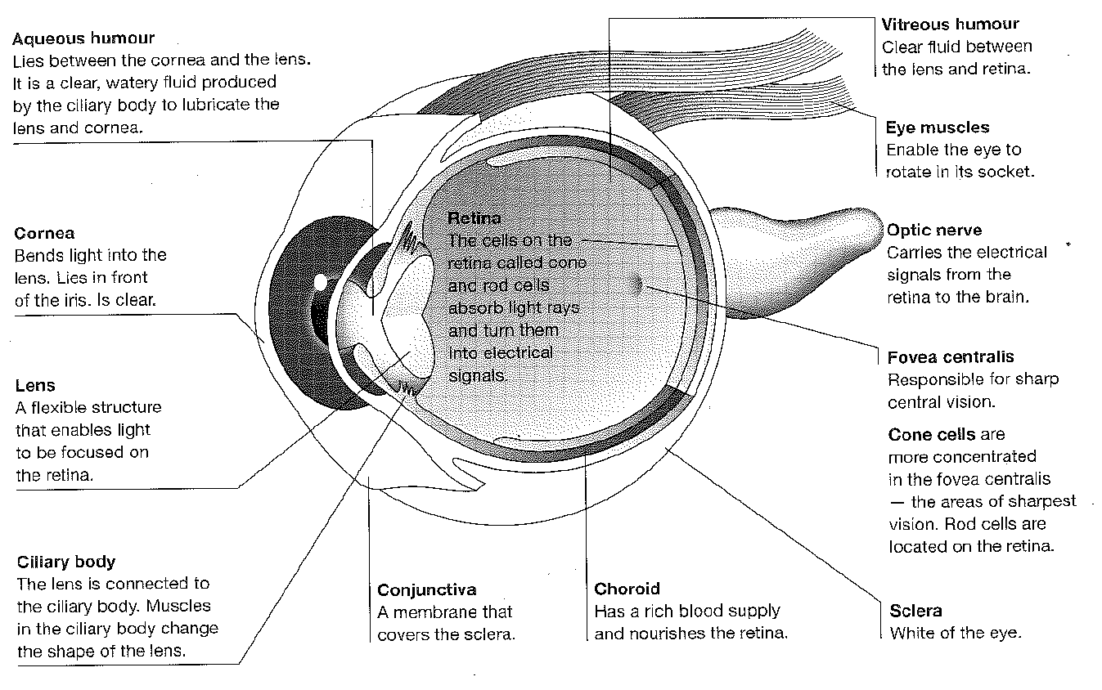

Slide 59
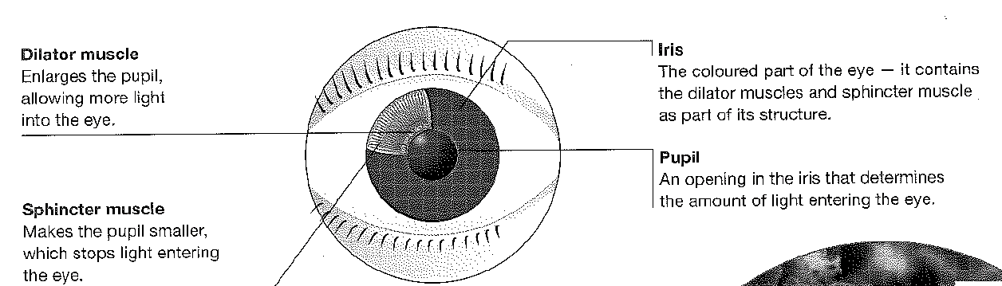

Slide 60
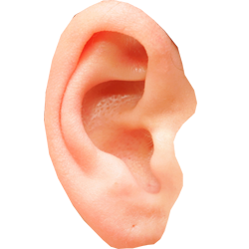
Structure of the ear
Your ear collects sound waves, amplify their vibrations and convert these into electrical impulses.
Your brain then interprets these impulses as sound.

Slide 61
Continued.
The human ear consists of three parts:
External ear
Middle ear
Internal ear

Slide 62
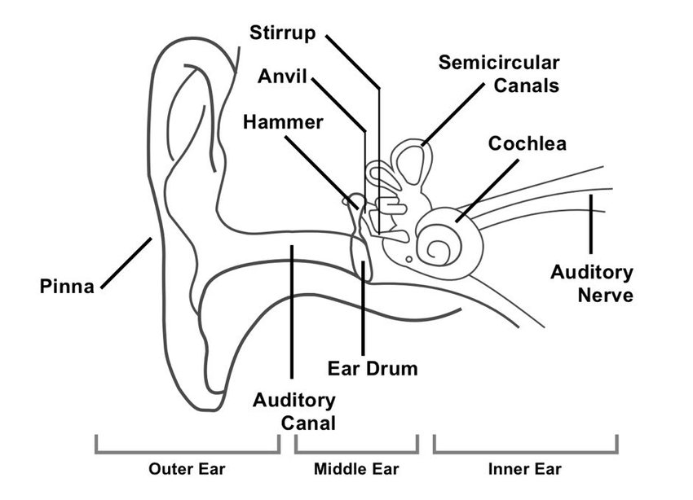

Slide 63
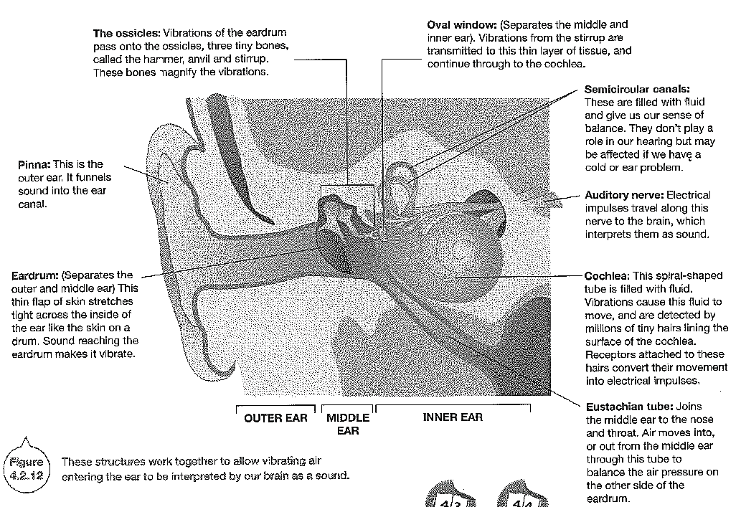

Slide 64
External Ear
The external ear is further divided into the following parts:
Auricle (Pinna): The auricle comprises a thin plate of elastic cartilage covered by a layer of skin. It consists of funnel-like curves that collect sound waves and transmits them to the middle ear. The lobule consists of adipose and fibrous tissues supplied with blood capillaries.
External Auditory Meatus: It is a slightly curved canal supported by bone in its interior part and cartilage in the exterior part. The meatus or the canal is lined with stratified epithelium and wax glands.
Tympanic Membrane: This membrane separates the middle ear and the external ear. This part receives and amplifies the sound waves. Its central part is known as the umbo

Slide 65
Middle Ear.
The middle ear comprises the following parts:
Tympanic Cavity: It is a narrow air-filled cavity separated from the external ear by tympanic membrane and from inner ear by the bony wall. The tympanic cavity has an auditory tube known as the eustachian tube in its anterior wall.
Eustachian Tube: The eustachian tube is a 4cm long tube that equalizes air pressure on either side of the tympanic membrane. It connects the tympanic cavity with the nasopharynx.
Ear Ossicles: These are responsible for transmitting sound waves from the eardrum to the middle ear. There are three ear ossicles in the human ear:
Malleus: A hammer-shaped part that is attached to the tympanic membrane through the handle and incus through the head. It is the largest ear ossicle.
Incus: An anvil-shaped ear ossicle connected with the stapes.
Stapes: It is the smallest ossicle and also the smallest bone in the human body.

Slide 66
Inner Ear.
It comprises two parts:
Bony Labyrinth: The bony labyrinth comprises a vestibule, three semi-circular canals, and spirally coiled cochlea. It is filled with perilymph.
Membranous labyrinth: The bony labyrinth surrounds the membranous labyrinth. It comprises sensory receptors responsible for balance and hearing. The membranous labyrinth is filled with endolymph and comprises three semi-circular ducts, cochlear duct, saccule and utricle. The sensory receptors include cristae, an organ of corti, and ampullaris maculae.

Slide 67
How it all connects.
The sensory system (including our eyes and ears) use specialised receptor cells in the skin and body to detect changes in the environment.
The receptors collect and convert physical stimuli into electrical and chemical signals through the transduction process and send these impulses to the nervous system for processing

Slide 68
Reflexes
A reflex is a rapid, automatic response to a change in the external or internal environment.
All reflexes have four important properties
A stimulus is required to trigger a reflex- the reflex is not spontaneous
A reflex is involuntary- it occurs without any conscious thought
A reflex response is rapid- only a small number of neurons are involved
A reflex response is stereotyped- it occurs in the same way each time it happens.

Slide 69
Continued.
Some reflexes involve the unconscious parts of the brain, but most are coordinated by the spinal cord.
When a nerve impulse comes into the spinal cord from a receptor, the message is not necessarily carried up to the brain.
The impulse may be passed to motor neurons at the same level in the cord, or may travel slightly up and down the cord before travelling out through a motor neuron.

Slide 70
Continued.
In these cases the reflex is carried out by the spinal cord alone and is known as a spinal reflex.
The pathway a nerve impulse follows in travelling from a receptor to an effector is known as a reflex arc or, in the case of a spinal reflex, a spinal reflex arc.

Slide 71
A reflex arc
A reflex arc has the following basic components:
1) A receptor is either the ending of a sensory neuron or a specialised cell associated with the end of a sensory neuron. The receptor reacts to a change in the internal or external environment by initiating a nerve impulse in the sensory neuron.

Slide 72
Continued.
2) A sensory neuron carries impulses from the receptor to the CNS.
3) There is a least one synapse. The nerve impulse may be passed directly to a motor neuron or there may be one or more interneurons, which direct the impulse to the correct moto neuron.

Slide 73
Continued.
4) A motor neuron carries the nerve impulse to an effector.
5) An effector receives the nerve impulse and carries out the appropriate response. Effectors are muscle cells or secretory cells.

Slide 74
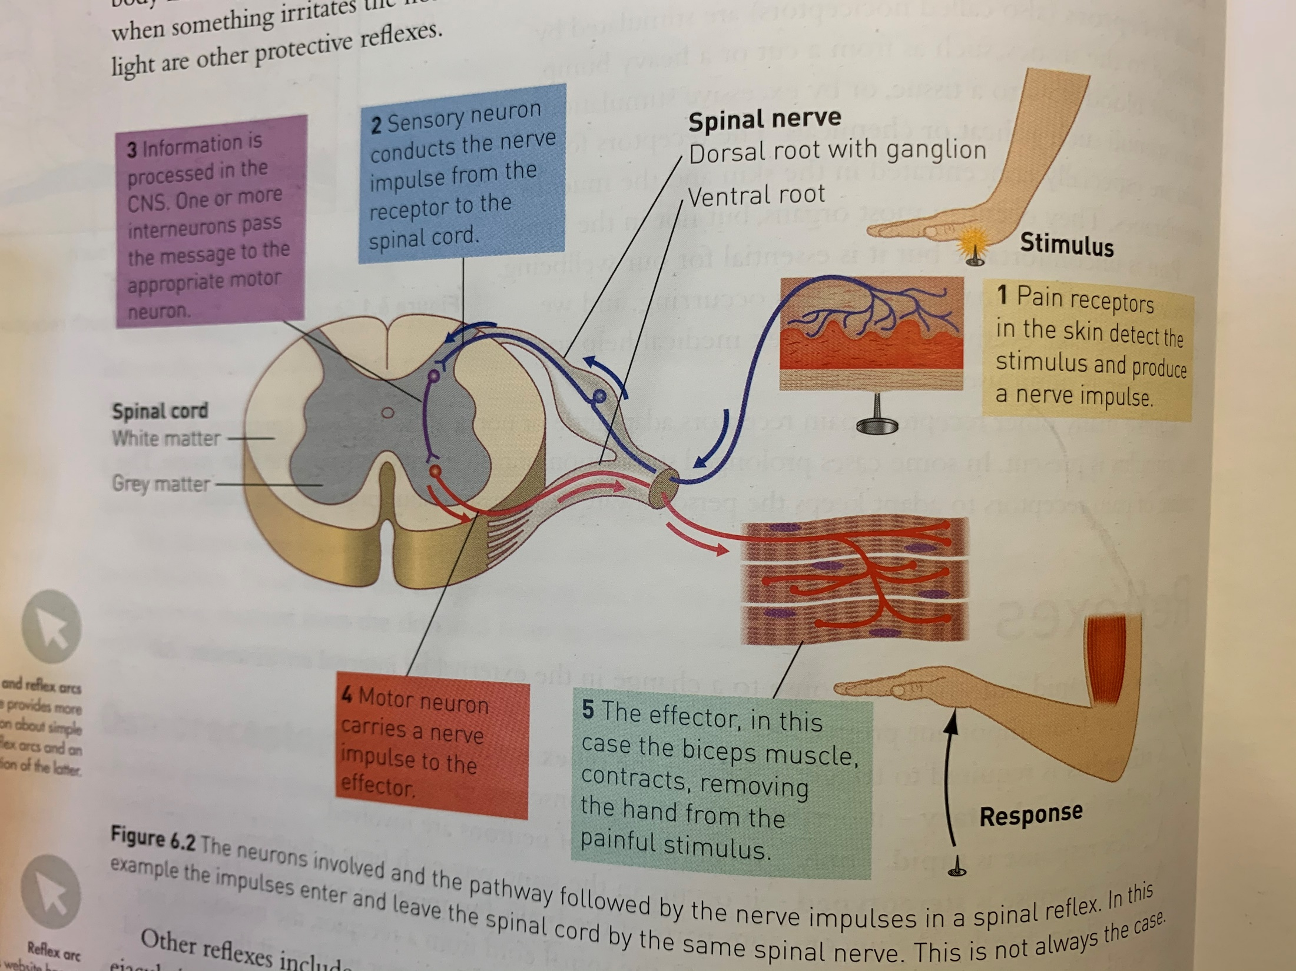

Slide 75
Neurons
Nerve cells or neurons, are the basic structural and functional units of the whole nervous system.
All consist of a cell body and two different types of extension from the cell- the dendrites and the axon.

Slide 76
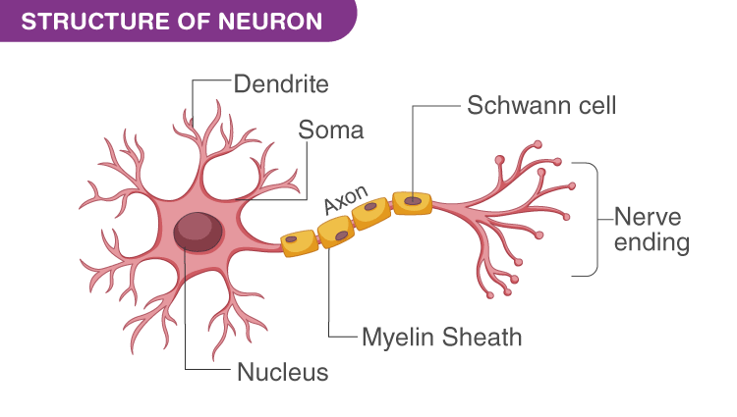

Slide 77
Continued.
Most of the neurons in the brain and many in the spinal cord are interneurons. They have many branches that are able to send or receive messages to or from adjacent neurons.

Slide 78
Cell body.
The cell body is a part of the neuron that contains the nucleus.
Around the nucleus is cytoplasm containing the organelles that are found in most cells- mitochondria, endoplasmic reticulum, ribosomes, and the Golgi apparatus.

Slide 79
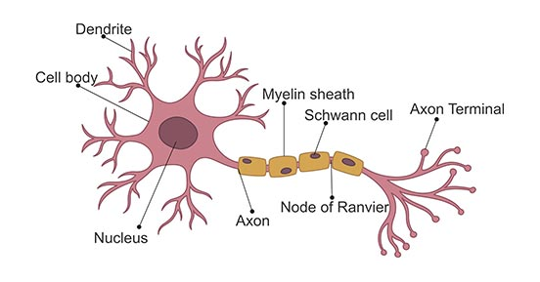

Slide 80
Dendrites.
Dendrites are usually fairly short extensions of the cytoplasm of the cell body.
They are often highly branched and they carry messages, or nerve impulses, into the cell body.

Slide 82
Axon
The axon is often a single, long extension of the cytoplasm.
It usually carries nerve impulses away from the cell body.
Most axons are covered with a layer of fatty material called the myelin sheath.

Slide 84
Types of Neurons
Sensory (or receptor) neurons: carry messages from receptors in the sense organs, or in the skin, to the CNS (brain and spinal cord)
Motor (or effector) neurons: carry messages from the CNS to the muscles and glands- the effectors.
Interneurons are located in the CNS and are the link between sensory and motor neurons.

Slide 85
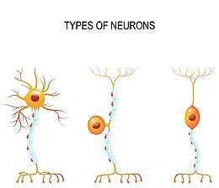
Motor Neurons
Sensory Neurons
Interneuron

Slide 86
Synapses
Nerve impulses have to be passed from neuron to neuron.
The junction between the branches of adjacent neurons is called the synapse.
The synapse is the tiny space between neurons.

Slide 87
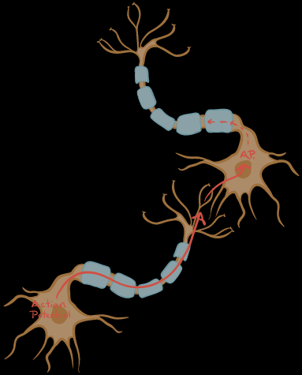

Slide 88
How do the nervous system and the musculoskeletal system interact to provide coordinated actions of the body for walking and balance?
10 marks

Slide 89
Your answer should include…..
Nervous system is a communication system that coordinates all our voluntary and involuntary actions through receiving and processing information from sense organs.
Musculoskeletal system provides our body with movement, support and stability.
They work together to provide coordinated actions due to the nervous system monitoring the external environment via sense organs and sending that information to the CNS (brain) where decisions are made concerning the movement/action that is to be taken and that instruction is sent via the PNS to the necessary parts of the musculoskeletal system (e.g. muscle and bones) to carry out the action (e.g. walking, movement).

